Slide 1
Jupyter Day Lightning Talk
7/17/2015

Slide 2



What is KBase?
Open software and data platform for addressing the grand challenge of systems biology: Predicting and designing biological function
Unified system that integrates data and analytical tools for comparative functional genomics of microbes, plants, and their communities
Collaborative environment for sharing methods and results and placing those results in the context of knowledge in the field
Notes:
Users can perform large-scale analyses and combine multiple lines of evidence to model plant and microbial physiology and community dynamics.
Enables collaboratively developed, data-driven, and formally testable models of biological function and behavior in environmental context.

Slide 3



Ultimate Goal
KBase is designed to become a true KNOWLEDGEBASE that . . .
Incorporates the exponentially increasing amount of biological data
Enables users to effectively operate on this Big Data
Integrates results across user-driven and automated analysis to infer biological function, from a single microbe to entire ecosystems

Slide 4
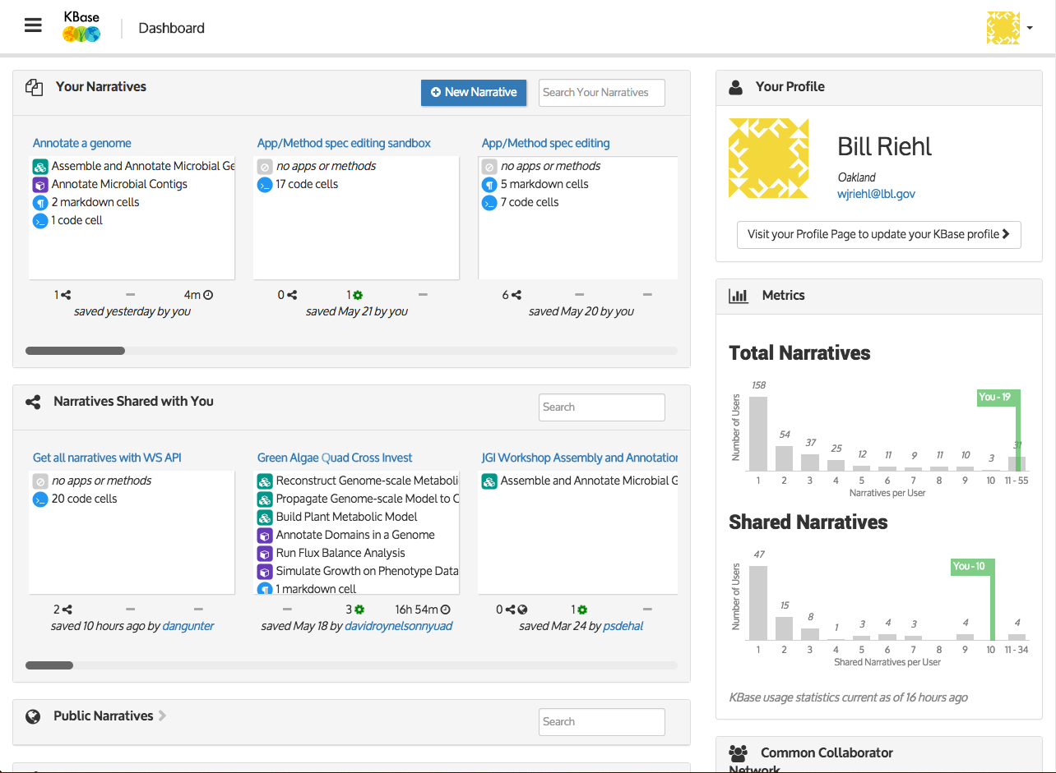

Slide 5
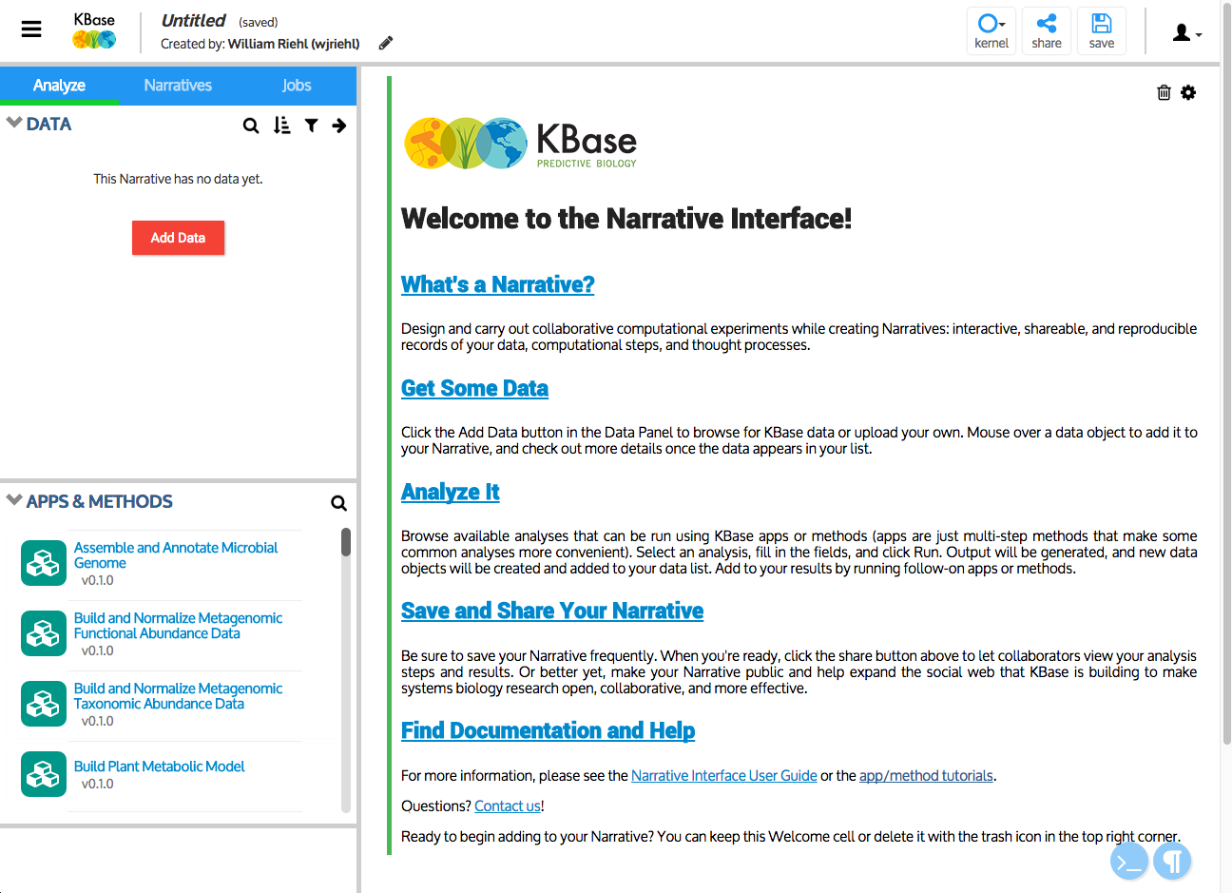

Slide 6
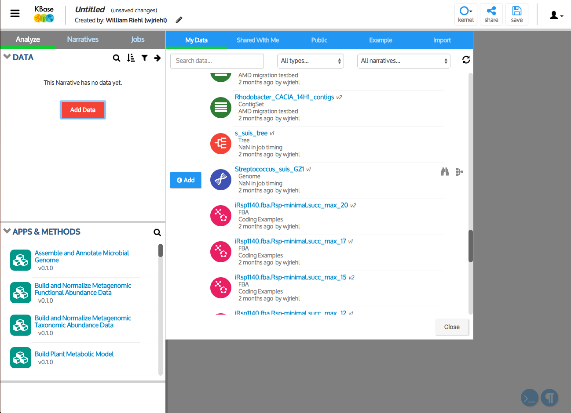

Slide 7
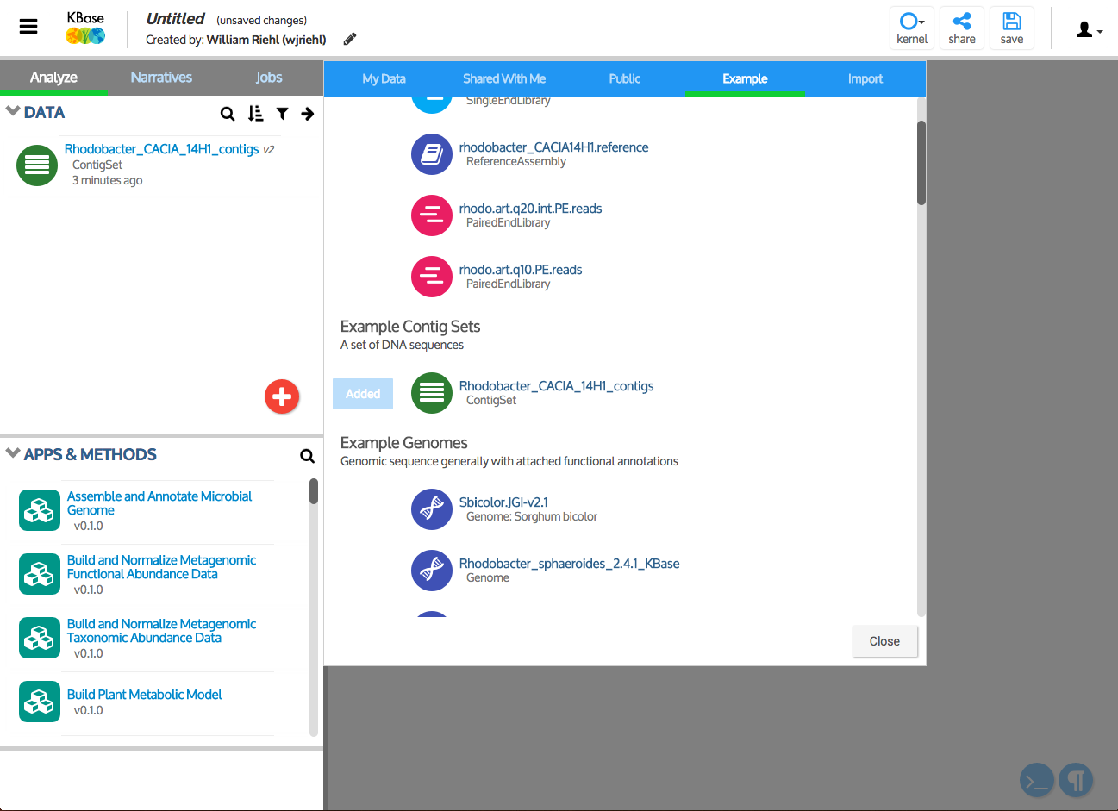

Slide 8
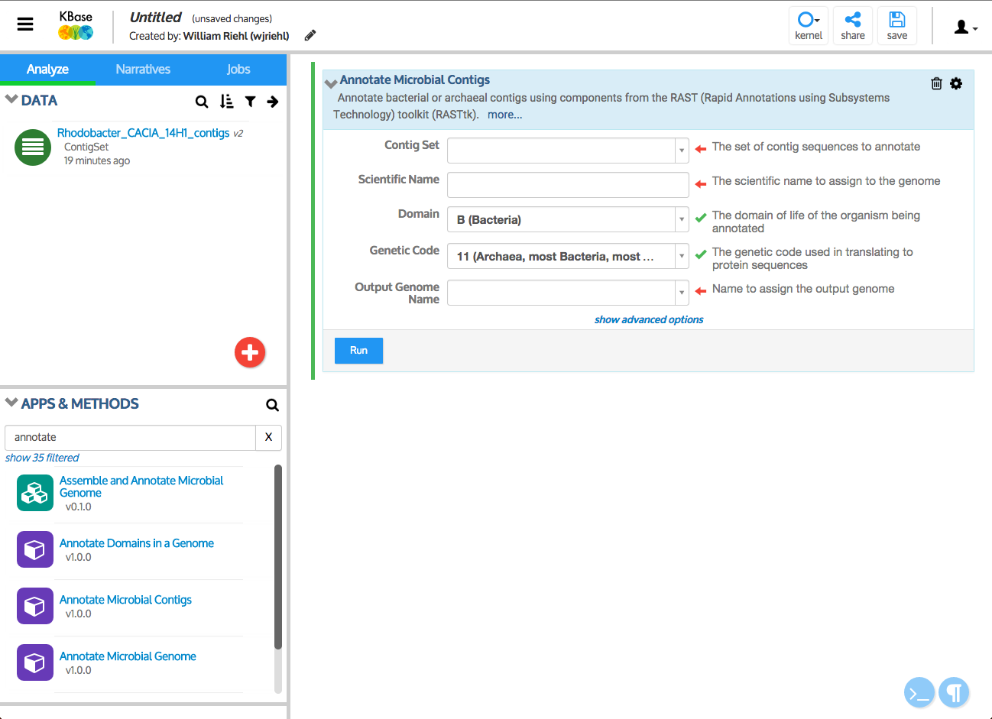

Slide 9
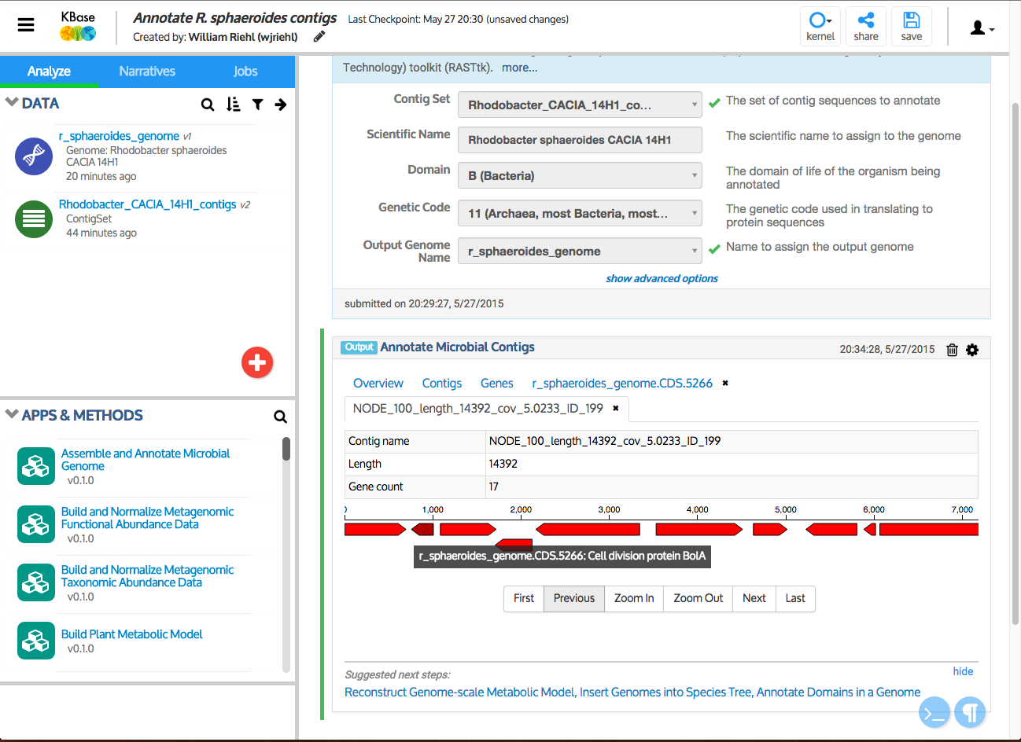

Slide 10
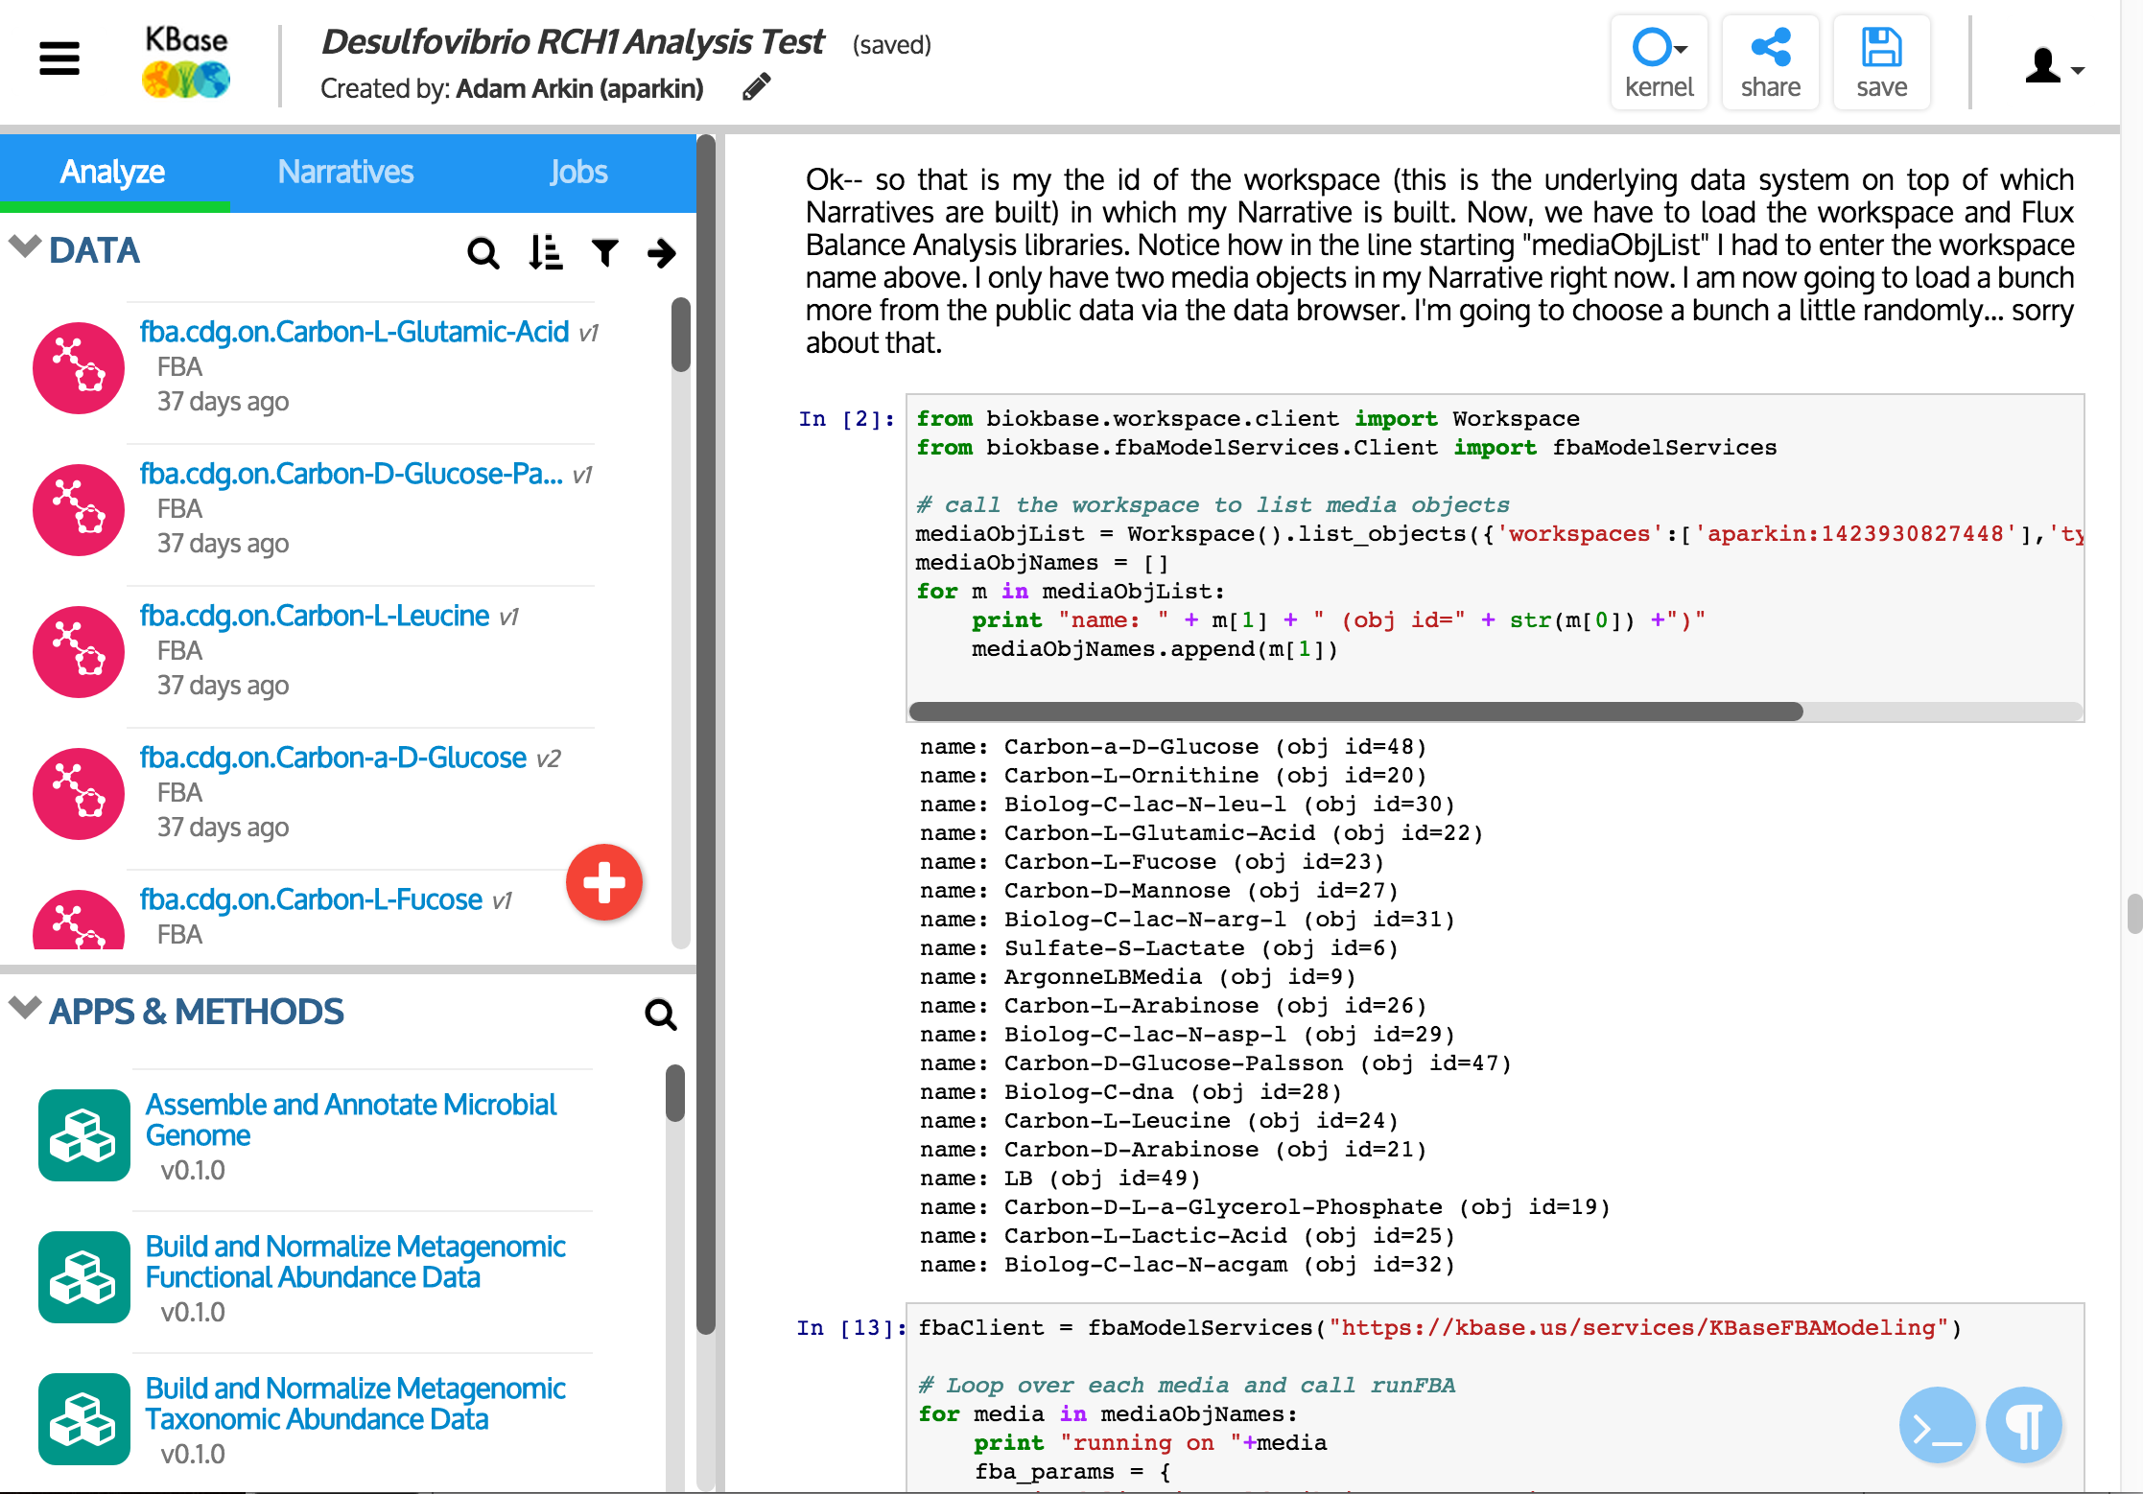

Slide 11



What’s Next?
TOOLS
• More functionality
• Controlled reintroduction of routes to third-party software integration
DATA
• Expanded, regularized cycle for data updates
• Improved data model
DESIGN
• Enhanced social interface
• Next-generation design for scalability and meta-analysis
PRODUCTION
• Improved reliability and resource utilization

